Slide 1
Digital Image Processing: Introduction

Slide 2
Introduction
“One picture is worth more than ten thousand words”
Anonymous

Slide 3
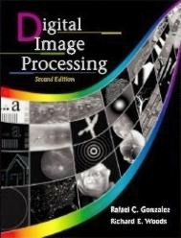
References
“Digital Image Processing”,
-Rafael C. Gonzalez & Richard E. Woods, Addison-Wesley, 2002

Slide 4
Contents
This lecture will cover:
What is a digital image?
What is digital image processing?
History of digital image processing
State of the art examples of digital image processing
Key stages in digital image processing

Slide 5
Introduction
Signal processing is a discipline in electrical engineering and in mathematics that deals with analysis and processing of analog and digital signals , and deals with storing , filtering , and other operations on signals. These signals include transmission signals , sound or voice signals , image signals , and other signals e.t.c.
Out of all these signals , the field that deals with the type of signals for which the input is an image and the output is also an image is done in image processing. As it name suggests, it deals with the processing on images.
It can be further divided into analog image processing and digital image processing.

Slide 6
Intro…
Analog image processing: Analog image processing is done on analog signals. It includes processing on two dimensional analog signals. In this type of processing, the images are manipulated by electrical means by varying the electrical signal. The common example include is the television image.
Digital image processing: The digital image processing deals with developing a digital system that performs operations on an digital image.

Slide 7
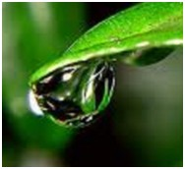
What is an Image
An image is nothing more than a two dimensional signal. It is defined by the mathematical function f(x,y) where x and y are the two co-ordinates horizontally and vertically.
The value of f(x,y) at any point is gives the pixel value at that point of an image.

Slide 8
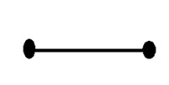
Different dimensions of signals
1 dimension signal
The common example of a 1 dimension signal is a waveform. It can be mathematically represented as
F(x) = waveform
Where x is an independent variable. Since it is a one dimension signal , so thats why there is only one variable x is used.
Pictorial representation of a one dimensional signal is given below:
The above figure shows a one dimensional signal.

Slide 9
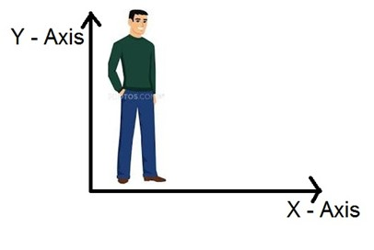
2 dimensions signal
The common example of a two dimensional signal is an image , which has already been discussed above.
As we have already seen that an image is two dimensional signal, i-e: it has two dimensions. It can be mathematically represented as:
F (x , y) = Image
Where x and y are two variables.

Slide 10
3 dimension signal
Three dimensional signal as it names refers to those signals which has three dimensions. We live in a three dimensional world. An example of a three dimensional signal is a cube or a volumetric data or the most common example would be animated or 3d cartoon character.
The mathematical representation of three dimensional signal is:
F(x,y,z) = animated character.

Slide 11
4 dimension signal
In a four dimensional signal , four dimensions are involved. The first three are the same as of three dimensional signal which are: (X, Y, Z), and the fourth one which is added to them is T(time). Time is often referred to as temporal dimension which is a way to measure change. Mathematically a four d signal can be stated as:
F(x,y,z,t) = animated movie.

Slide 12
Pixel
Pixel is the smallest element of an image. Each pixel correspond to any one value. In an 8-bit gray scale image, the value of the pixel between 0 and 255. The value of a pixel at any point correspond to the intensity of the light photons striking at that point. Each pixel store a value proportional to the light intensity at that particular location.
PEL
A pixel is also known as PEL.

Slide 13

What is a Digital Image?
A digital image is a representation of a two-dimensional image as a finite set of digital values, called picture elements or pixels
Images taken from Gonzalez & Woods, Digital Image Processing (2002)
Notes:
Real world is continuous – an image is simply a digital approximation of this.

Slide 14

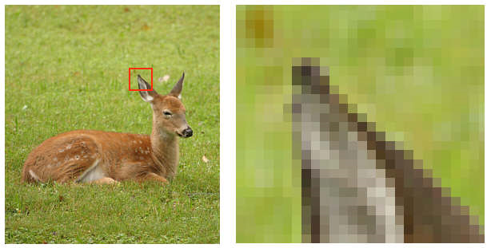
What is a Digital Image? (cont…)
Pixel values typically represent gray levels, colours, heights, opacities etc
Remember digitization implies that a digital image is an approximation of a real scene
Images taken from Gonzalez & Woods, Digital Image Processing (2002)
1 pixel

Slide 15
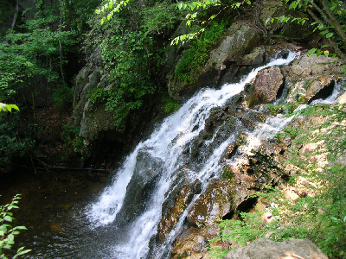

What is a Digital Image? (cont…)
Common image formats include:
1 sample per point (B&W or Grayscale)
3 samples per point (Red, Green, and Blue)
4 samples per point (Red, Green, Blue, and “Alpha”, a.k.a. Opacity)
For most of this course we will focus on grey-scale images

Slide 16
What is Digital Image Processing?
Digital image processing focuses on two major tasks
Improvement of pictorial information for human interpretation
Processing of image data for storage, transmission and representation for autonomous machine perception
Some argument about where image processing ends and fields such as image analysis and computer vision start

Slide 17
What is DIP? (cont…)
The continuum from image processing to computer vision can be broken up into low-, mid- and high-level processes
Low Level Process
Mid Level Process
High Level Process
Input: Image Output: Image
Examples: Noise removal, image sharpening
Input: Image Output: Attributes
Examples: Object recognition, segmentation
Input: Attributes Output: Understanding
Examples: Scene understanding, autonomous navigation
In this course we will stop here
Notes:
Give the analogy of the character recognition system.
Low Level: Cleaning up the image of some text
Mid level: Segmenting the text from the background and recognising individual characters
High level: Understanding what the text says

Slide 18
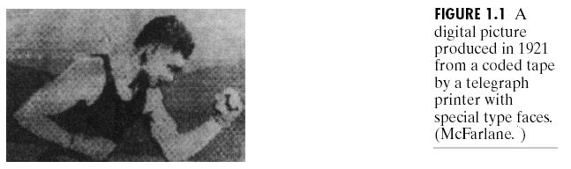
History of Digital Image Processing
Early 1920s: One of the first applications of digital imaging was in the news- paper industry
The Bartlane cable picture transmission service
Images were transferred by submarine cable between London and New York
Pictures were coded for cable transfer and reconstructed at the receiving end on a telegraph printer
Early digital image
Images taken from Gonzalez & Woods, Digital Image Processing (2002)

Slide 19
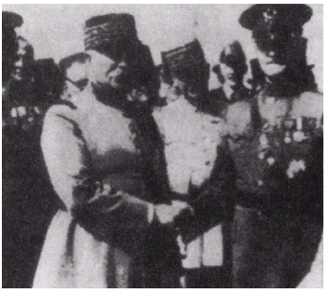
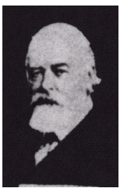
History of DIP (cont…)
Mid to late 1920s: Improvements to the Bartlane system resulted in higher quality images
New reproduction processes based on photographic techniques
Increased number of tones in reproduced images
Images taken from Gonzalez & Woods, Digital Image Processing (2002)
Improved digital image
Early 15 tone digital image

Slide 20
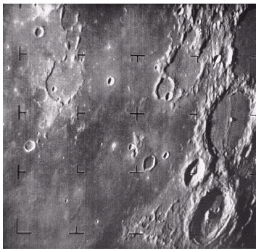
History of DIP (cont…)
1960s: Improvements in computing technology and the onset of the space race led to a surge of work in digital image processing
1964: Computers used to improve the quality of images of the moon taken by the Ranger 7 probe
Such techniques were used in other space missions including the Apollo landings
Images taken from Gonzalez & Woods, Digital Image Processing (2002)
A picture of the moon taken by the Ranger 7 probe minutes before landing

Slide 21
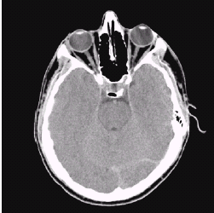
History of DIP (cont…)
1970s: Digital image processing begins to be used in medical applications
1979: Sir Godfrey N. Hounsfield & Prof. Allan M. Cormack share the Nobel Prize in medicine for the invention of tomography, the technology behind Computerised Axial Tomography (CAT) scans
Images taken from Gonzalez & Woods, Digital Image Processing (2002)
Typical head slice CAT image

Slide 22
History of DIP (cont…)
1980s - Today: The use of digital image processing techniques has exploded and they are now used for all kinds of tasks in all kinds of areas
Image enhancement/restoration
Artistic effects
Medical visualisation
Industrial inspection
Law enforcement
Human computer interfaces

Slide 23
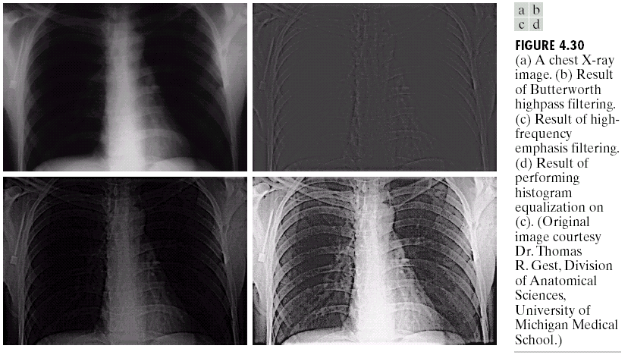
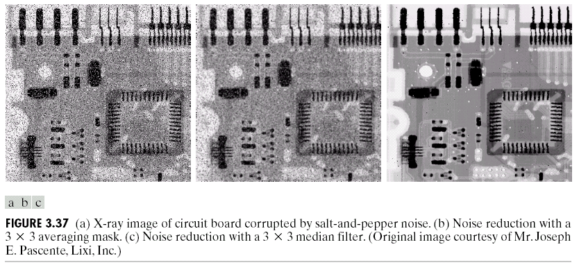
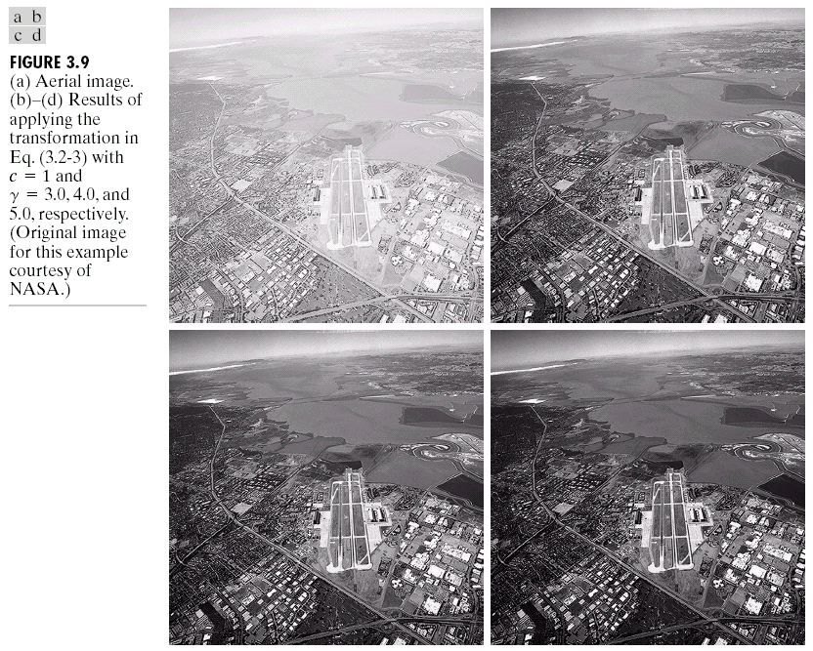
Examples: Image Enhancement
One of the most common uses of DIP techniques: improve quality, remove noise etc
Images taken from Gonzalez & Woods, Digital Image Processing (2002)

Slide 24
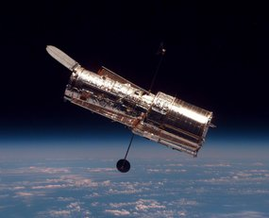
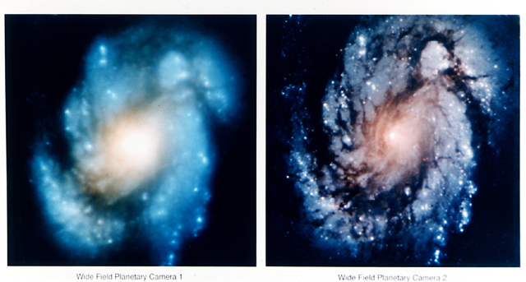
Examples: The Hubble Telescope
Launched in 1990 the Hubble telescope can take images of very distant objects
However, an incorrect mirror made many of Hubble’s images useless
Image processing techniques were used to fix this

Slide 25
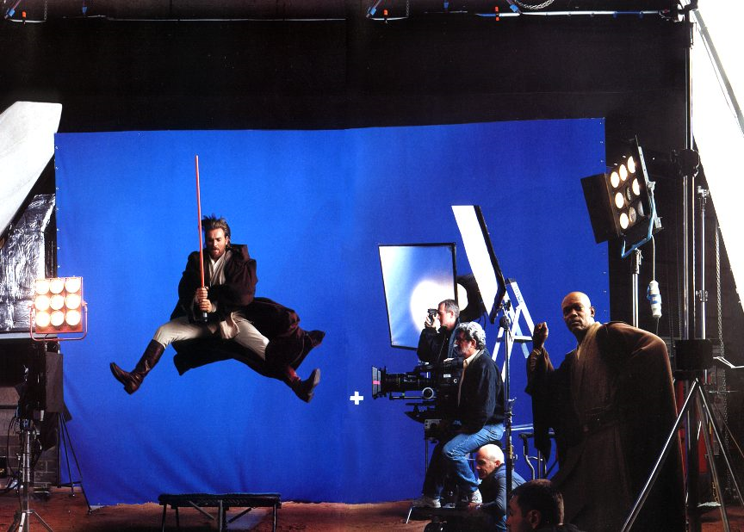
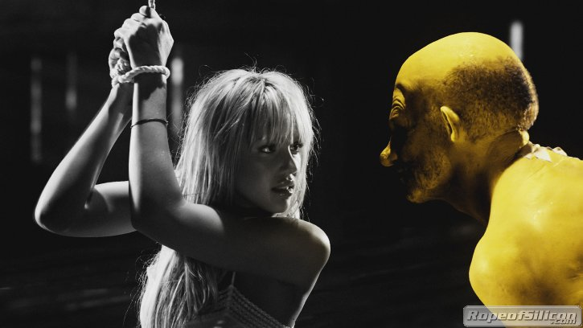
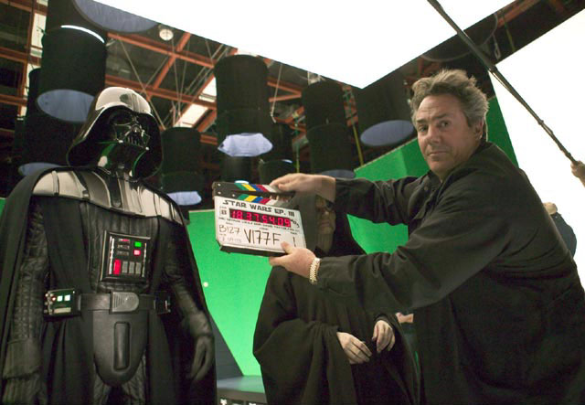
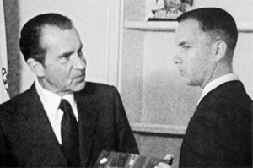
Examples: Artistic Effects
Artistic effects are used to make images more visually appealing, to add special effects and to make composite images

Slide 26
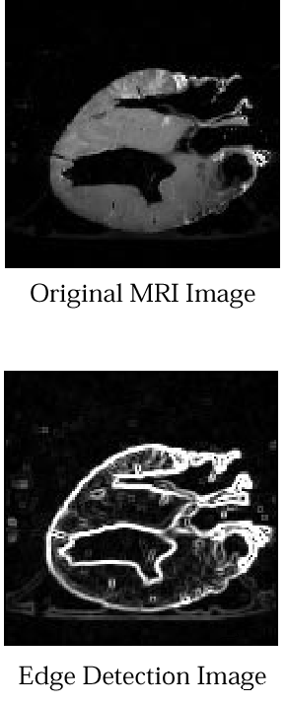
Examples: Medicine
Take slice from MRI scan of canine heart, and find boundaries between types of tissue
Image with gray levels representing tissue density
Use a suitable filter to highlight edges
Images taken from Gonzalez & Woods, Digital Image Processing (2002)
Original MRI Image of a Dog Heart
Edge Detection Image

Slide 27
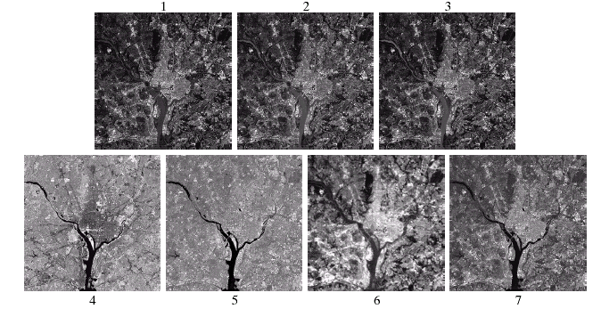
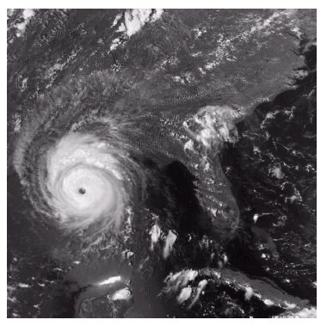
Examples: GIS
Geographic Information Systems
Digital image processing techniques are used extensively to manipulate satellite imagery
Terrain classification
Meteorology
Images taken from Gonzalez & Woods, Digital Image Processing (2002)

Slide 28
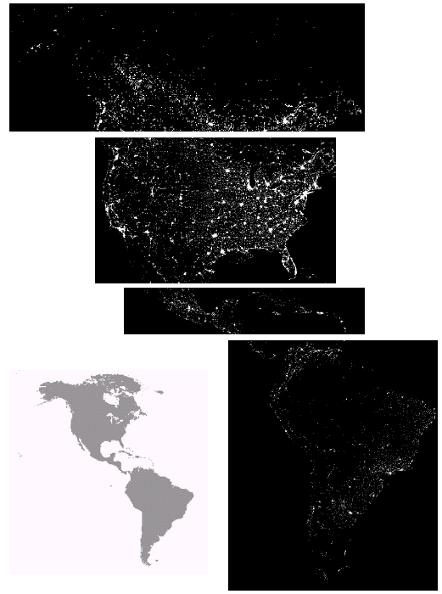
Examples: GIS (cont…)
Night-Time Lights of the World data set
Global inventory of human settlement
Not hard to imagine the kind of analysis that might be done using this data
Images taken from Gonzalez & Woods, Digital Image Processing (2002)

Slide 29
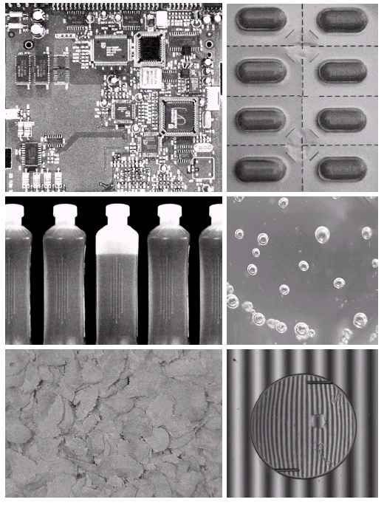
Examples: Industrial Inspection
Human operators are expensive, slow and unreliable
Make machines do the job instead
Industrial vision systems are used in all kinds of industries
Images taken from Gonzalez & Woods, Digital Image Processing (2002)

Slide 30
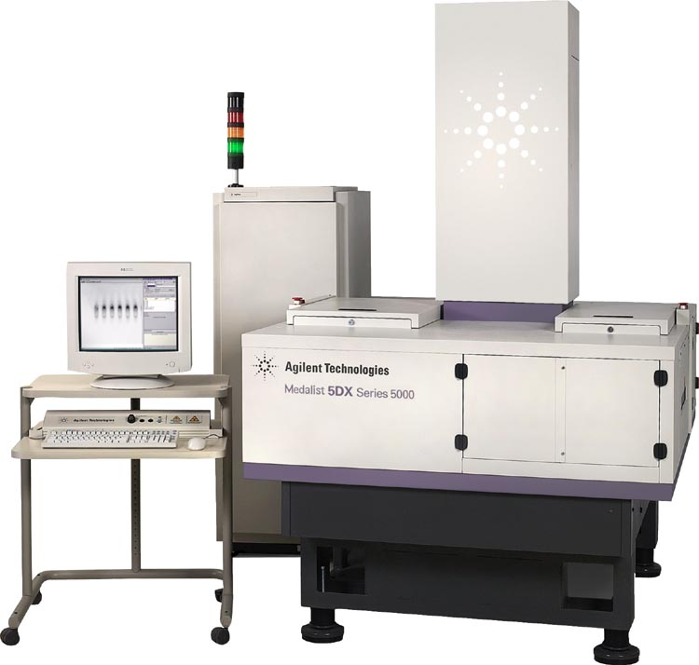
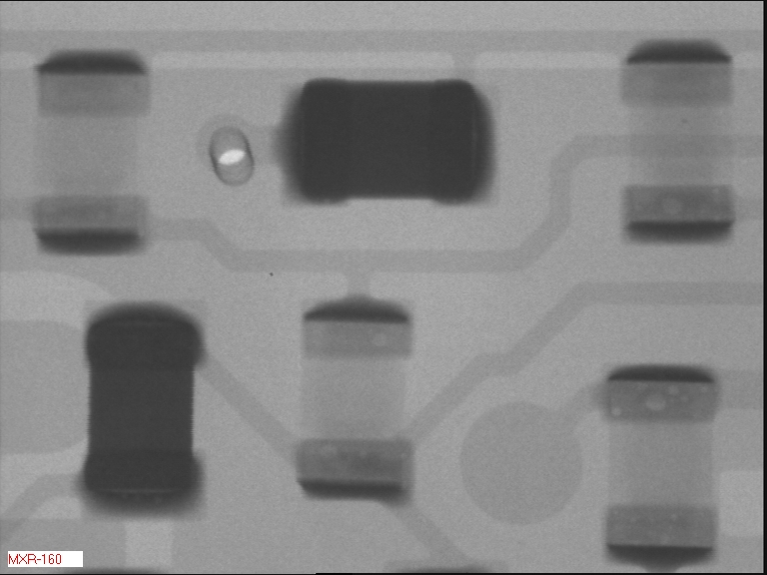
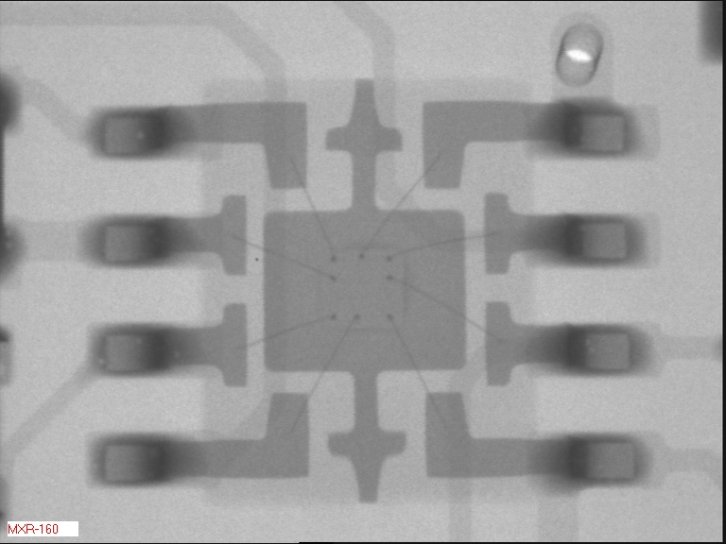
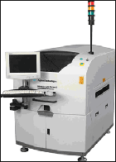
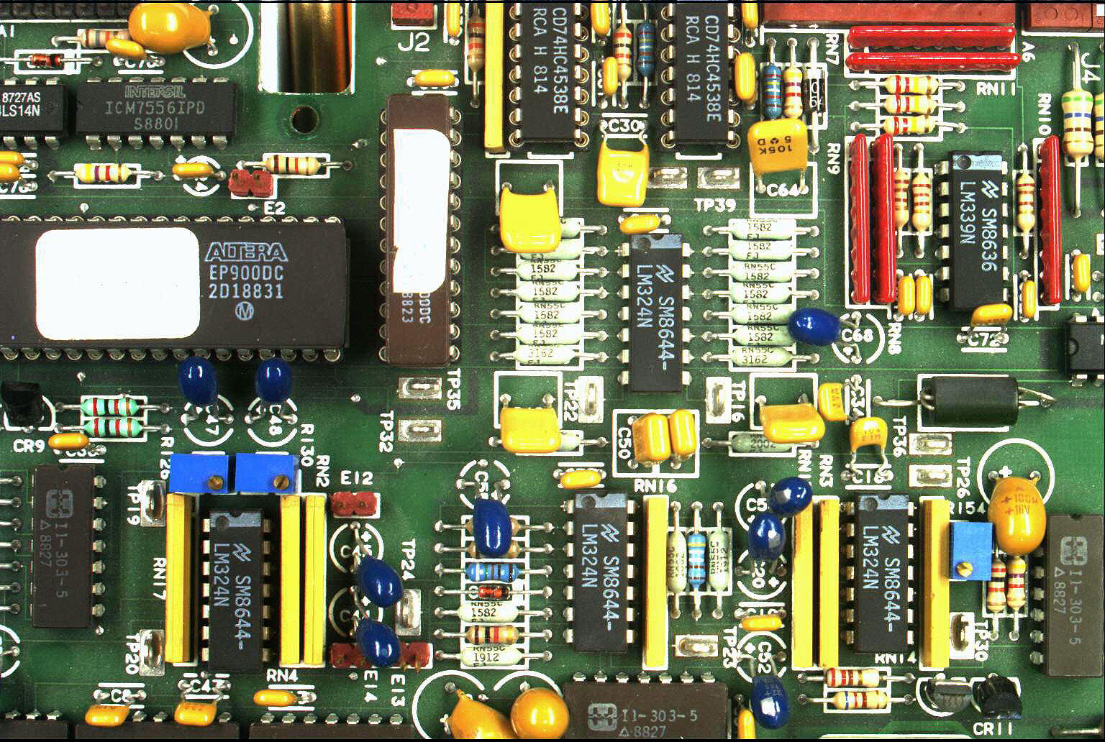
Examples: PCB Inspection
Printed Circuit Board (PCB) inspection
Machine inspection is used to determine that all components are present and that all solder joints are acceptable
Both conventional imaging and x-ray imaging are used

Slide 31
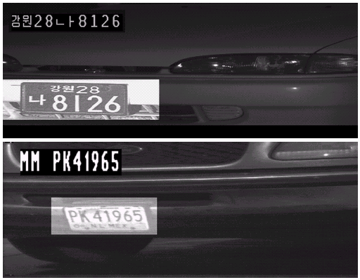
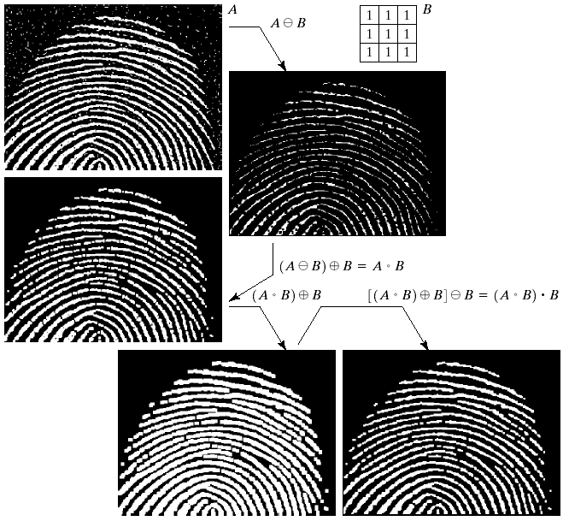
Examples: Law Enforcement
Image processing techniques are used extensively by law enforcers
Number plate recognition for speed cameras/automated toll systems
Fingerprint recognition
Enhancement of CCTV images
Images taken from Gonzalez & Woods, Digital Image Processing (2002)

Slide 32
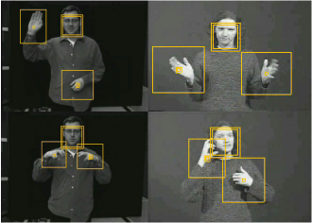
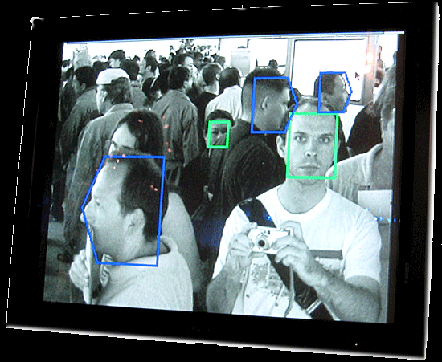
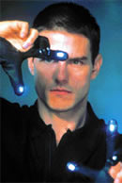
Examples: HCI
Try to make human computer interfaces more natural
Face recognition
Gesture recognition
Does anyone remember the user interface from “Minority Report”?
These tasks can be extremely difficult

Slide 33
Key Stages in Digital Image Processing
Image Restoration
Morphological Processing
Image Enhancement
Segmentation
Image Acquisition
Object Recognition
Representation & Description
Problem Domain
Colour Image Processing
Image Compression

Slide 34
Key Stages in Digital Image Processing: Image Aquisition
Image Restoration
Morphological Processing
Image Enhancement
Segmentation
Image Acquisition
Object Recognition
Images taken from Gonzalez & Woods, Digital Image Processing (2002)
Representation & Description
Problem Domain
Colour Image Processing
Image Compression

Slide 35
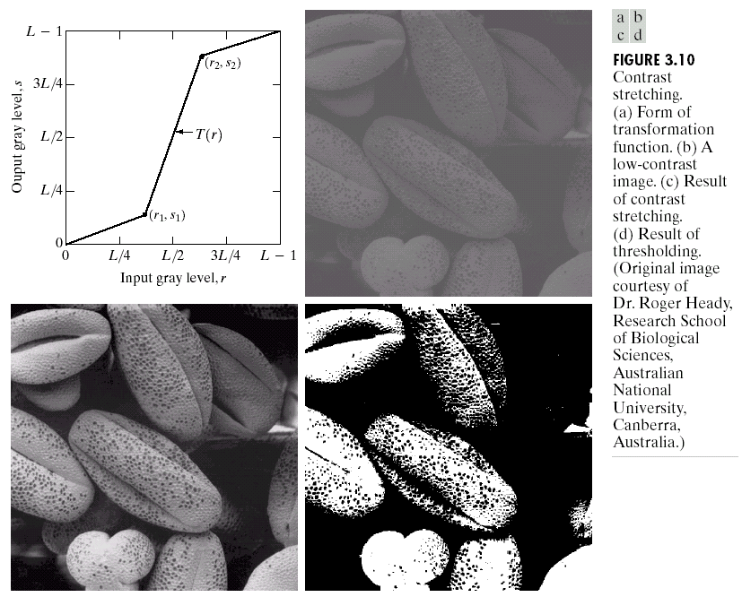
Key Stages in Digital Image Processing: Image Enhancement
Image Restoration
Morphological Processing
Image Enhancement
Segmentation
Image Acquisition
Object Recognition
Images taken from Gonzalez & Woods, Digital Image Processing (2002)
Representation & Description
Problem Domain
Colour Image Processing
Image Compression

Slide 36
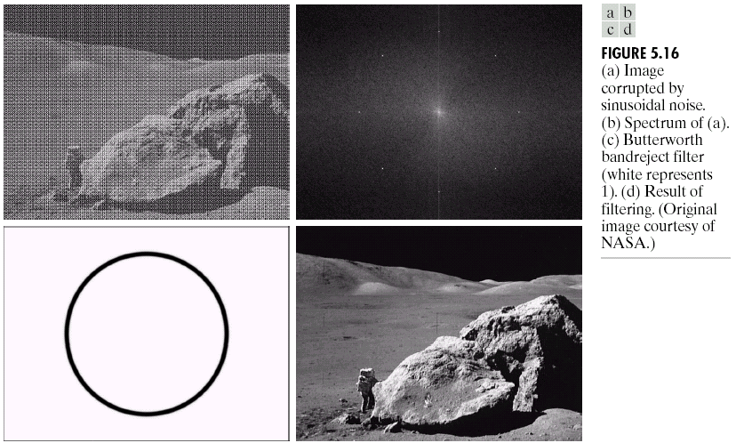
Key Stages in Digital Image Processing: Image Restoration
Image Restoration
Morphological Processing
Image Enhancement
Segmentation
Image Acquisition
Object Recognition
Images taken from Gonzalez & Woods, Digital Image Processing (2002)
Representation & Description
Problem Domain
Colour Image Processing
Image Compression

Slide 37
Key Stages in Digital Image Processing: Morphological Processing
Image Restoration
Morphological Processing
Image Enhancement
Segmentation
Image Acquisition
Object Recognition
Images taken from Gonzalez & Woods, Digital Image Processing (2002)
Representation & Description
Problem Domain
Colour Image Processing
Image Compression

Slide 38
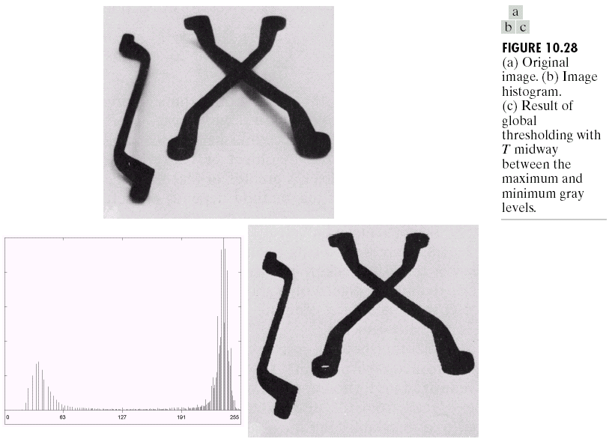
Key Stages in Digital Image Processing: Segmentation
Image Restoration
Morphological Processing
Image Enhancement
Segmentation
Image Acquisition
Object Recognition
Images taken from Gonzalez & Woods, Digital Image Processing (2002)
Representation & Description
Problem Domain
Colour Image Processing
Image Compression

Slide 39
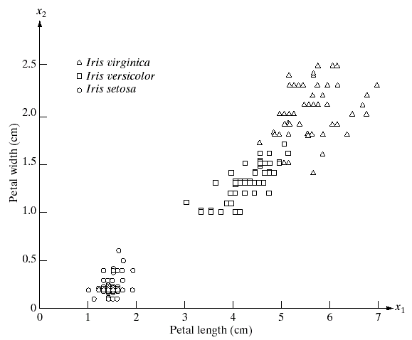
Key Stages in Digital Image Processing: Object Recognition
Image Restoration
Morphological Processing
Image Enhancement
Segmentation
Image Acquisition
Object Recognition
Images taken from Gonzalez & Woods, Digital Image Processing (2002)
Representation & Description
Problem Domain
Colour Image Processing
Image Compression

Slide 40
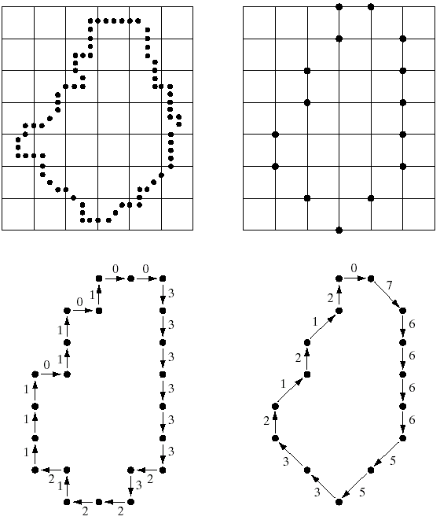
Key Stages in Digital Image Processing: Representation & Description
Image Restoration
Morphological Processing
Image Enhancement
Segmentation
Image Acquisition
Object Recognition
Images taken from Gonzalez & Woods, Digital Image Processing (2002)
Representation & Description
Problem Domain
Colour Image Processing
Image Compression

Slide 41
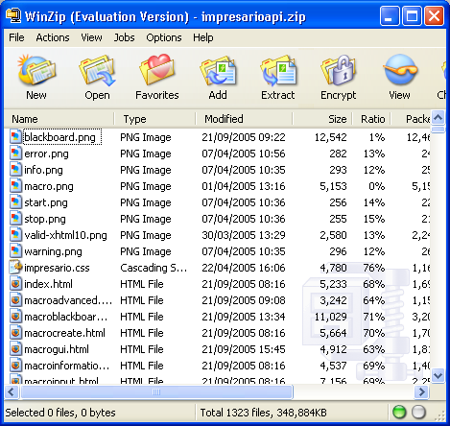
Key Stages in Digital Image Processing: Image Compression
Image Restoration
Morphological Processing
Image Enhancement
Segmentation
Image Acquisition
Object Recognition
Representation & Description
Problem Domain
Colour Image Processing
Image Compression

Slide 42
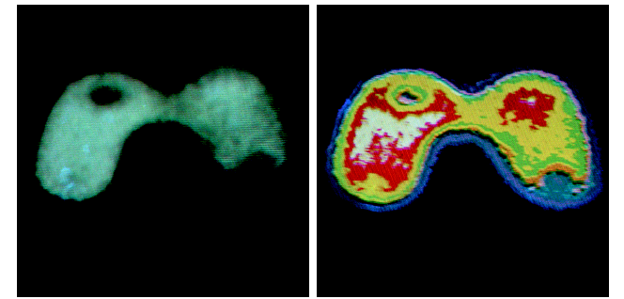
Key Stages in Digital Image Processing: Colour Image Processing
Image Restoration
Morphological Processing
Image Enhancement
Segmentation
Image Acquisition
Object Recognition
Representation & Description
Problem Domain
Colour Image Processing
Image Compression

